Slide 1

Introduction to Computer Science & Scratch
Binary
Representing Data
Algorithms
Solving Problems
Pseudocode
Introduction Scratch
Hello World
Starting with Scratch
Mohamed Tamer Amen

Slide 2
Outline
Introduction
Opening a file
Reading from a file
Writing to a file
Closing a file
Reading from the Web

Slide 3
Introduction
File Processing: is the process of reading or writing to a file and manipulating its data.
File processing operations include:
Opening a file
Reading from a file
Writing to a file
Closing the file

Slide 4
Opening a File
Before we can read the contents of the file, we must tell Python which file we are going to work with and what we will be doing with the file
This is done using the open() function
open() returns a “file handle” - a variable used to perform operations on the file
Kind of like “File -> Open” in a Word Processor

Slide 5
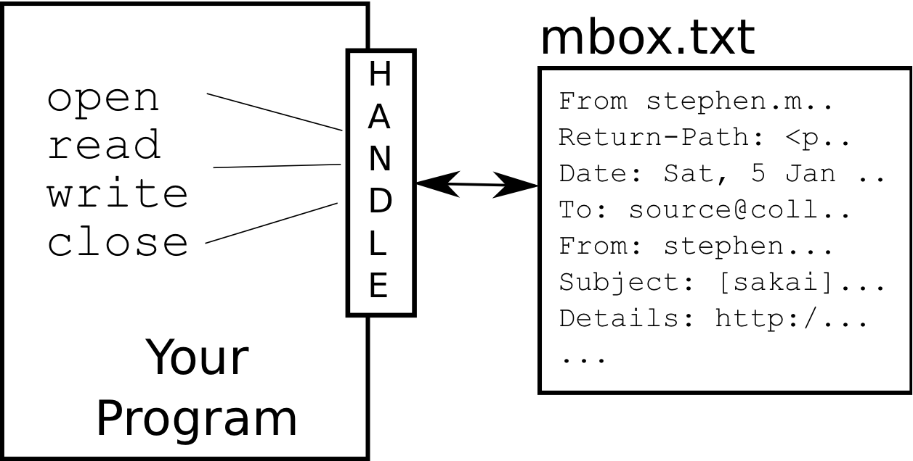
What is a Handle?
>>> fhand = open('mbox.txt')
>>> print (fhand)
<open file 'mbox.txt', mode 'r' at 0x1005088b0>

Slide 6
Opening a file
To open a file we use function
open(<file name>, <open mode>)
Name is a string with the actual file name on the disk.
Open mode can be
Read “r”
Write “w”
Append “a”
depending on whether we are reading, writing or appending in the file.
Example:
>>> f = open ("C:\\file1.txt",'r')
>>> print f
>>> type (f)
<type 'file'>

Slide 7
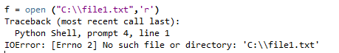
Opening a file
To open a file we use function
open(<file name>, <open mode>)
Name is a string with the actual file name on the disk.
Open mode can be
Read “r”
Write “w”
Append “a”
depending on whether we are reading, writing or appending in the file.
Example:
>>> f = open ("C:\\file1.txt",'r')
>>> print f
>>> type (f)
<type 'file'>
Unless the file already exists, you will get an error:

Slide 8
Opening a file
To open a file we use function
open(<file name>, <open mode>)
Name is a string with the actual file name on the disk.
Open mode can be
Read “r”
Write “w”
Append “a”
depending on whether we are reading, writing or appending in the file.
Example:
>>> fo = open ("C:\\file2.txt",’w')
>>> print fo
>>> type (fo)
<type 'file’>
if the file does not exist, it will be created;
If the file already exists, it will overwrite its contents

Slide 9
Opening a file
To open a file we use function
open(<file name>, <open mode>)
Name is a string with the actual file name on the disk.
Open mode can be
Read “r”
Write “w”
Append “a”
depending on whether we are reading, writing or appending in the file.
Example:
>>> fo = open ("C:\\file2.txt",’a')
>>> print fo
>>> type (fo)
<type 'file'>
if the file does not exist, it will be created;
If the file already exists, it will point at the beginning of its contents waiting for your commands (read or write).
If you want to add then you need to move to its end to add content.

Slide 10
Reading from a file
How to read data from the file ?
There are 3 different methods to read data from files
readline () → returns the next line in the file as a string.
readlines ()→ returns all lines in the file as a list of strings (lines)
read() → returns the entire file content as one string.
Example:
>>> fin = open ( 'file1.txt' , 'r' )
>>> Line = fin.readline()
>>> Lines = fin.readlines()

Slide 11
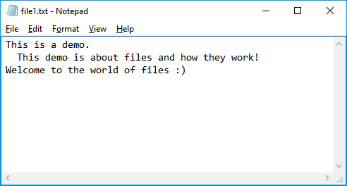
file1.txt
Assume the following contents in file1.txt

Slide 12
The newline Character
We use a special character to indicate when a line ends called the "newline"
We represent it as \n in strings
Newline is still one character - not two
>>> stuff = 'X\nY’
>>> print (stuff)
X
Y
>>> len (stuff)
3

Slide 13

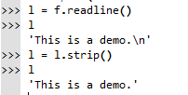
A closer look at reading lines

Slide 14

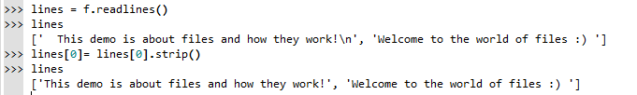
A closer look at reading lines

Slide 15
Reading from a file (cont.)
read() : reads the entire contents of the file content as a string including “newline” characters “\n”.

Slide 16
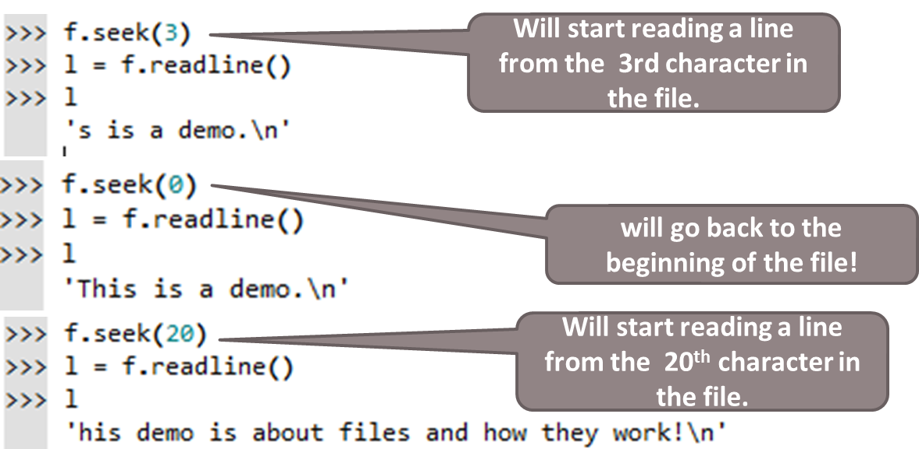
Reading from a file (cont.)
Seek (offset) method: sets the file's current position at the offset (character position).

Slide 17
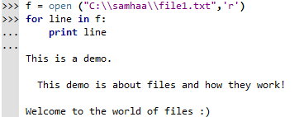
Looping over the contents of a file

Slide 18
Searching Through a File
We can put an if statement in our for loop to only print lines that meet some criteria
fhand = open('mbox-short.txt')
for line in fhand:
if line.startswith('From:') :
print (line)

Slide 19
Searching Through a File (fixed)
We can strip the whitespace from the right hand side of the string using rstrip() from the string library
The newline is considered "white space" and is stripped
fhand = open('mbox-short.txt')
for line in fhand:
line = line.rstrip()
if line.startswith('From:') :
print (line)
From: stephen.marquard@uct.ac.za
From: louis@media.berkeley.edu
From: zqian@umich.edu
From: rjlowe@iupui.edu
....

Slide 20
Using in to select lines
We can look for a string anywhere in a line as our selection criteria
fhand = open('mbox-short.txt')
for line in fhand:
line = line.rstrip()
if '@uct.ac.za' in line :
print (line)
From stephen.marquard@uct.ac.za Sat Jan 5 09:14:16 2008
X-Authentication-Warning: set sender to stephen.marquard@uct.ac.za using –f
From: stephen.marquard@uct.ac.zaAuthor: stephen.marquard@uct.ac.za
From david.horwitz@uct.ac.za Fri Jan 4 07:02:32 2008
X-Authentication-Warning: set sender to david.horwitz@uct.ac.za using -f...

Slide 21
Prompt for File Name
fname = input('Enter the file name: ')
fhand = open(fname)
count = 0
for line in fhand:
if line.startswith('Subject:') :
count = count + 1
print ('There were', count, 'subject lines in', fname)
Enter the file name: mbox.txt
There were 1797 subject lines in mbox.txt
Enter the file name: mbox-short.txt
There were 27 subject lines in mbox-short.txt

Slide 22
Closing files
Whether you are reading or writing you always need to close a file after you’re done processing it .
In some cases, not properly closing a file could result in data loss.
To close a file , use the close( ) method
Example:
>>> f.close()

Slide 23
Writing to a file
To write to a file , use “w” open mode. What will happen to the file in “w” mode ??
File exists: clear the file’s contents.
File doesn’t exists: a new one is created.
Example:
>>> f =open ("file2.txt",'w')
>>> f.write ("Hello")
>>> f.close()

Slide 24
Writing to a file (Cont.)
What if you want to write data to your file? Lets take the example of wanting to write numbers!
Example:
>>> f =open ("file2.txt",'w')
>>> f.write (7)
TypeError: expected a character buffer object
Use the string formatting operators %
Example:
>>> f =open ("file2.txt",'w')
>>> n= 7
>>> f.write ("this is number %d" %(n))

Slide 25
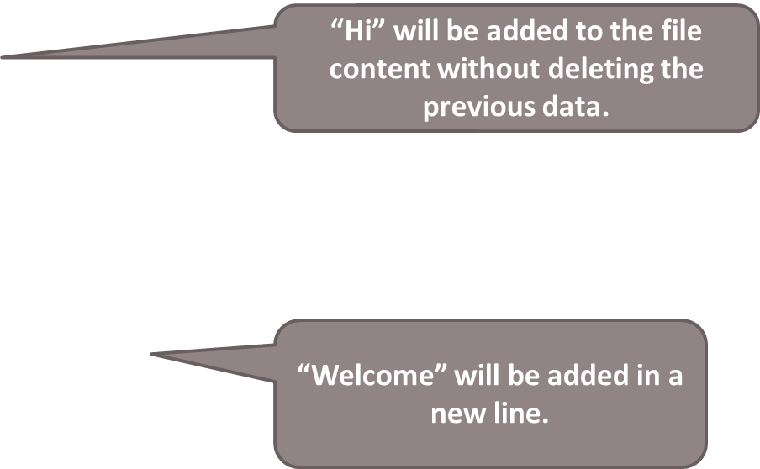
Writing to a file (Cont.)
To append the file content without deleting the original content, use “a” open mode
Example:
>>> f =open ("file2.txt",'a')
>>> f.write ("Hi")
>>> f.close()
To write a new line in the file, use “ \n”
Example:
>>> f =open ("file2.txt",'a')
>>> f.write ("\n Welcome")
>>> f.close()

Slide 26
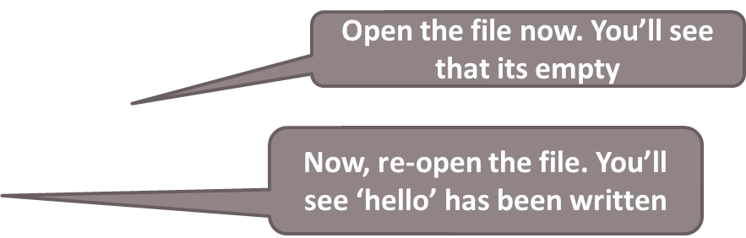
The flush method
Data is usually buffered in memory before its actually written to a file.
You will notice that you will only see what you have written to file after closing it.
If you want to force the contents of the buffer to be written to the file, you can use the flush method.
Example:
f =open ("file2.txt",‘w')
f.write(“hello")
f.flush()

Slide 27
Reading from URLs!!
import urllib
url = "http://www.nileu.edu.eg/"
web_page = ur llib.urlopen(url)
for line in web_page:
line = line.strip()
print line
web_page.close()

